Slide 1
From 5,000 to 0
Prioritizing Documents for Remediation
October 13, 2021
Office of Natural Resources Revenue
Maroya Faied, Supervisory Digital Services Specialist
Shannon McHarg, User Experience Designer
Lindsay Goldstein, Program Analyst

Slide 2


Who we are
The Office of Natural Resources Revenue collects, accounts for, and verifies natural resource and energy revenues due to states, Native Americans, and the U.S. Treasury.

Slide 3
About ONRR.gov

Slide 4
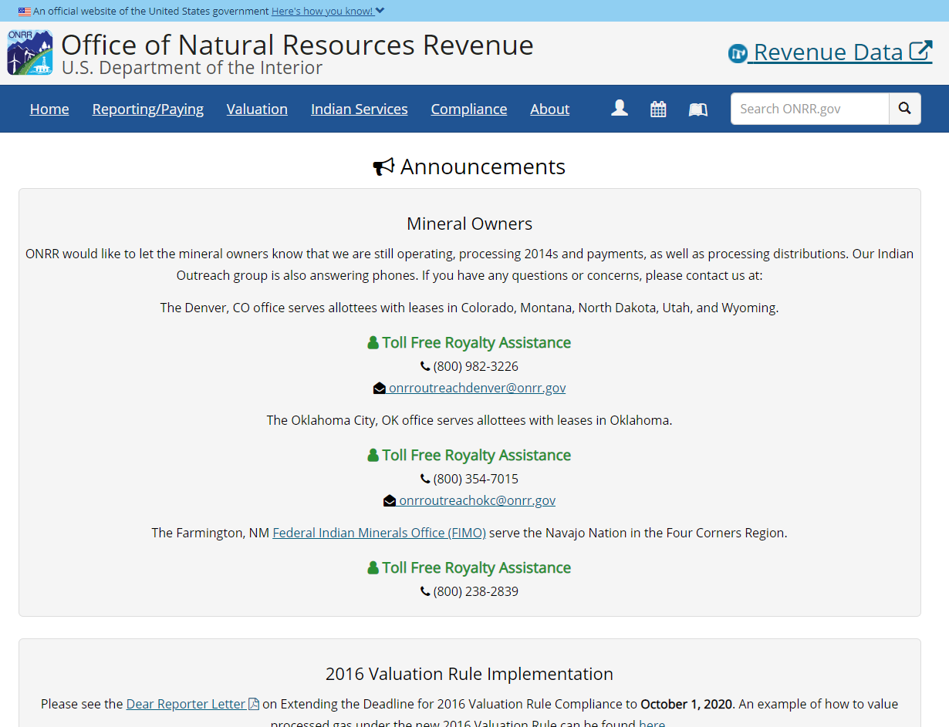
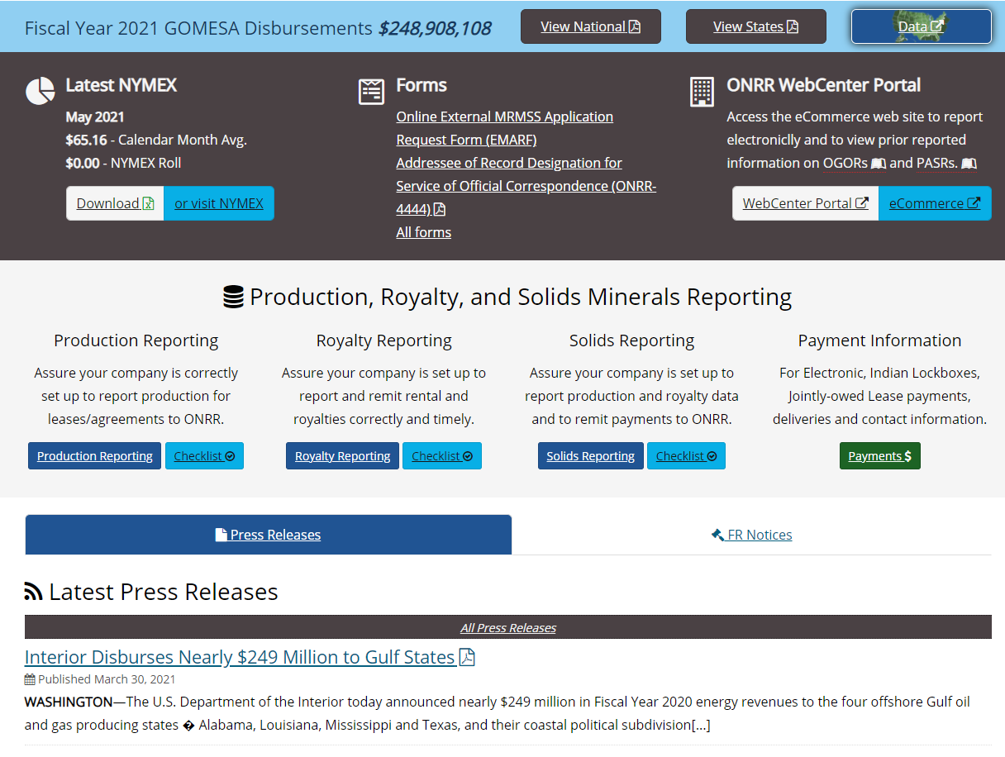
ONRR.gov current state
https://www.onrr.gov/

Slide 5
ONRR.gov problem statement
Companies pay to produce natural resources on federal lands, Indian lands, and the Outer Continental Shelf. They need to access timely and accurate information to meet complex regulatory requirements. These requirements include reporting production and paying the required royalties and other revenues. The Office of Natural Resources Revenue collects, verifies, and disburses those revenues.
Native Americans and the public need to understand their revenues and ensure we meet our trust responsibilities. ONRR should provide access to resources and clear communication to help this understanding.

Slide 6
ONRR.gov vision
We communicate the role of the Office of Natural Resources Revenue. We deliver trusted and easy to use information and customer service. This enables companies who lease federal and Indian lands to accurately report production and pay revenue due.

Slide 7
Who uses ONRR.gov
Oil, gas, mineral industry
Production reporter
Royalty reporter/payor
Solids reporter/payor
New reporter
ONRR customer service rep
Resource owner (tribe, Individual Indian Mineral Owner (IIMO))
Inquisitor

Slide 8
Initial request

Slide 9
Director’s mandate
When the Director of the Office of Natural Resources Revenue (ONRR) decided to ensure all documents on onrr.gov are Section 508 compliant in July of 2020, we thought it would be a reasonable project.

Slide 10
508, the newest buzzword
After ONRR’s director started the push to make documents compliant, “508 compliance” became a “buzzword” at our agency.

Slide 11
People started asking what 508 compliance was
In short, in 1998, Congress amended the Rehabilitation Act of 1973 to require Federal agencies to make their electronic and information technology (EIT) accessible to people with disabilities, covered under Section 508 of the Act.
“Great,” you say, “who’s responsible within my organization?”
Short Answer: Anyone who creates content to share must ensure they follow the minimum requirements.

Slide 12
Planning
We needed a plan to correct all the documents currently on the website and a plan for any new documents requested to be uploaded on the website.

Slide 13
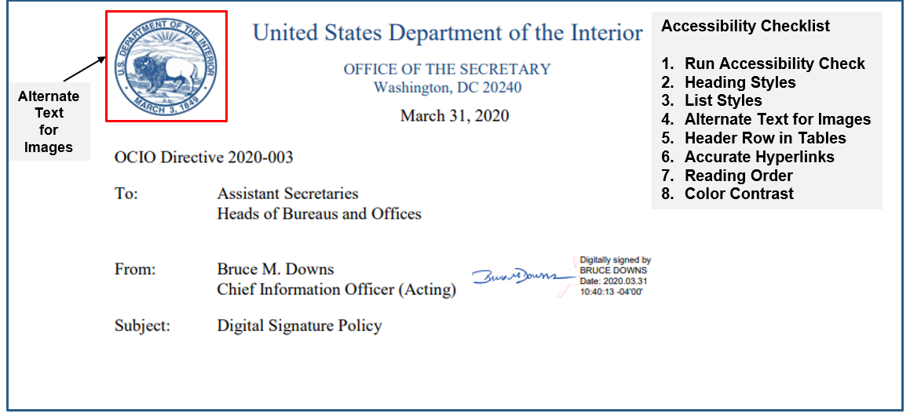
Example of an Accessible Electronic Document

Slide 14
New document policy

Slide 15
Policy for new documents
Electronic documents submitted after September 1, 2020 are not posted to ONRR.gov if they don’t meet accessibility requirements.
With our Director’s support, we sent an agency-wide notification that we are no longer uploading any new documents on the website unless they pass the accessibility checks.

Slide 16
Document owner responsibility
It’s the program area/document owner’s responsibility to create accessible documents.
Document owners should use available accessibility checks within the application used to create the document.
Our team provides instructions through our GitHub Wiki to assist with these checks.

Slide 17
Open Data, Design, and Development review
Our team uses Adobe Acrobat or Office to scan and confirm accessibility.
If there are errors, the document is returned to the document owner with the accessibility report. This report details specific errors and corrective actions to be taken.
If it’s a rushed document, the document owner can request approval from the Deputy Director to post immediately, but it will need to be corrected within 2 days.

Slide 18
Existing document prioritization

Slide 19
Existing Documents
Then we started going through the content inventory that one of last year’s interns had put together and found out there were over 3,000 documents on the site.
That made the project seem daunting.
We weren’t sure we’d be able to get through all the documents in less than several years.

Slide 20
Existing Documents: Phase 0
Open Data, Design, and Development categorized and prioritized the documents and provided the document schedule to leadership.
We included all documents, no matter how old.
Program managers determined who needed to take training and would be responsible for correcting the documents.
All document owners took the training to learn how to create accessible documents.

Slide 21
Analytics
To start making sense of the pile of documents, we looked at our site’s analytics to rank the documents by usage.
We knew we should fix the most used documents first.
We also found more documents that weren’t in the content inventory.

Slide 22
Project plan
We put together a project plan that broke down the project into three phases.
We emphasized that documents should be corrected by the owner since they are the subject matter experts of their own documents, and accessibility is everyone’s responsibility.

Slide 23
Tracking spreadsheet
Throughout all three phases, we’ve been keeping track of the documents in a spreadsheet that tracks the current status of each document, which phase it’s in, who owns it, a link to the accessibility report, and who on our team checked the report.
We’ve also cross-referenced this list with our content inventory to make sure we know where each document lives on the site when we update or remove it.

Slide 24
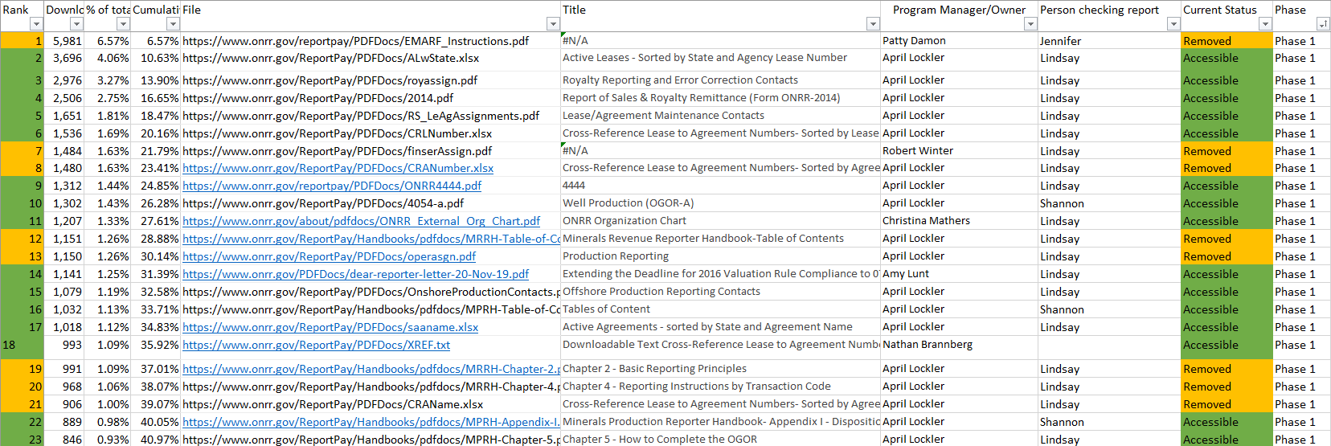
Tracking spreadsheet (visual)

Slide 25
Phases
Phase 1
Top 100 most downloaded documents (70% of downloads).
Phase 2
Next 100 most downloaded documents (14% of downloads).
Phase 3
Remainder of about 3,000 documents (16% of downloads).

Slide 26
Section 508 compliance documents by phase

Slide 27
Existing Documents: Phase 1
We were happy to learn that 70% of downloads over the course of a year were of the top 100 documents. We split those first 100 documents off as phase 1.

Slide 28
Phase 1 documents by team
Team | Documents | Percent
Reference & Reporting Management (RRM) | 67 | 68%
Royalty Valuation (RV) | 9 | 9%
Financial Management | 8 | 8%
Chief of Staff | 4 | 4%
Office of the Deputy Director | 2 | 2%
Appeals & Regulations | 2 | 2%
Indian Trust, Outreach & Coordination (ITOC) | 2 | 2%
Analytics & Risk Management | 2 | 2%
Enforcement & Litigation Support | 1 | 1%
Infrastructure & Digital Services (IDS) | 1 | 1%
Information & Data Management (IDM) | 1 | 1%

Slide 29
Phase 1 process
At the beginning of phase 1, we ran accessibility reports on each document.
We sent each owner a list of the documents assigned to them for the phase along with the accessibility report.
We also provided a link to our wiki with resources to make documents accessible.
We also gave the owners a deadline of about eight weeks from the start date.
One program area had the bulk of the documents, so we gave them a longer deadline of 20 weeks.

Slide 30
Existing Documents: Phase 2
Phase 2 covers the next 100 most downloaded documents (covers ~14% of downloads).

Slide 31
Phase 2 documents by team
Team | Documents | Percent
Reference & Reporting Management (RRM) | 45 | 45%
Royalty Valuation (RV) | 35 | 35%
Compliance Management | 4 | 4%
Financial Management | 4 | 4%
Indian Trust, Outreach & Coordination (ITOC) | 3 | 3%
Enforcement & Litigation Support | 3 | 3%
Appeals & Regulations | 3 | 3%
Infrastructure & Digital Services (IDS) | 2 | 2%
Chief of Staff | 1 | 1%
Office of the Deputy Director | 1 | 1%

Slide 32
Phase 2 process
We sent each document owner their list of documents and accessibility reports.
We gave document owners another eight weeks to complete phase 2, but it went faster than phase 1 because the document owners were now familiar with making documents accessible.

Slide 33
Existing Documents: Phase 3
Then we had the long tail of phase 3. This phase included over 3,000 documents downloaded fewer than 100 times each in a year.
To break up phase 3, we categorized the remaining documents.

Slide 34
Phase 3 documents by team
Team | Documents | Percent
Appeals & Regulations | 2,144 | 67%
Reference & Reporting Management (RRM) | 244 | 8%
Analytics & Risk Management | 244 | 8%
Royalty Valuation (RV) | 182 | 6%
Chief of Staff | 146 | 5%
Office of the Deputy Director | 72 | 2%
Financial Management | 51 | 2%
Infrastructure & Technology Services | 36 | 1%
Enforcement & Litigation Support | 20 | 1%
Audit Management | 11 | 0%
Information & Data Management (IDM) | 10 | 0%
Infrastructure & Digital Services (IDS) | 8 | 0%
Indian Trust, Outreach & Coordination (ITOC) | 8 | 0%
Compliance Management | 6 | 0%
MRMSS Management | 3 | 0%

Slide 35
Phase 3 documents by category
Category | Documents | Percent
Comments (FRN) | 1,288 | 40%
Federal Register Notices (FRNs) | 463 | 15%
Reporter Letters | 341 | 11%
Pricing | 202 | 6%
ICR Package | 150 | 5%
Press Releases | 146 | 5%
OMB Notice of Action | 114 | 4%
Training | 101 | 3%
Handbooks | 78 | 2%
Minutes/Transcripts | 47 | 1%
Presentations & Testimony | 42 | 1%
Form | 37 | 1%
Compliance | 22 | 1%
Unbundling | 22 | 1%
IONR Documents | 21 | 1%
Production Reporting | 19 | 1%
Category | Documents | Percent
Solids | 16 | 1%
MOUs & SOPs | 11 | 0%
FOIA | 10 | 0%
About | 10 | 0%
Other | 8 | 0%
Public Laws | 8 | 0%
Indian | 7 | 0%
Payments | 6 | 0%
Notice of Meeting | 5 | 0%
Royalty Reporting | 3 | 0%
Appeals | 3 | 0%
Valuation | 2 | 0%
Setup | 1 | 0%
Public Comments | 1 | 0%
Contacts | 1 | 0%

Slide 36
Federal register documents
The bulk of the phase 3 documents were Federal Register Notices and public comments on those notices.
Our regulations team had told us we could link out to the Federal Register website for the notices instead of hosting our own pdfs of them.
To do this, we had our data intern find the appropriate links to the Federal Register, and I got to work replacing those documents. That reduced the number of documents by 460.
Finding links to replace the public comments with wasn’t easy, so the regulations team found us links and told us which we could remove. That allowed us to remove 1,288 more documents from the site.

Slide 37
Phase 3 process
For the rest of phase 3, we wanted the document owners to decide whether to keep the documents before we ran accessibility reports.
We gave the owners a list of documents along with how infrequently they were downloaded to make this decision.

Slide 38
Existing Documents: Unlinked Documents
As we were going through the phase 3 documents, it became clear that there were about 2,100 extra documents in our website folder.
We assumed that these documents were not linked on the site because they didn’t appear in the content inventory.
Rather than spend time prioritizing these documents, we put them all in a “not linked” folder.
We’ll put them back if anyone complains about a broken link. Otherwise, we will not bring them to the new site.

Slide 39
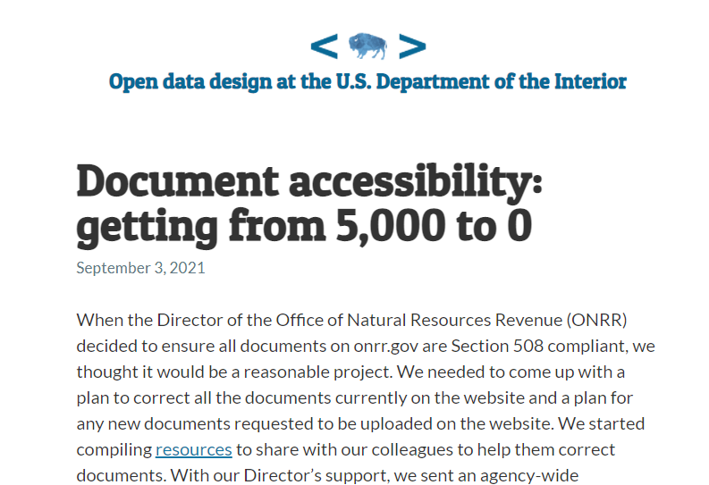
Updating Documents
Keeping track of the documents was only a small part of the undertaking. The people doing most of the work were the subject matter experts who were updating their documents.
Learn more about the process of updating documents in our blog post.

Slide 40
Project status
3,385
evaluated
+
2,160
unlinked documents
=
5,545
total documents
683
made accessible
2,525
removed or replaced with external links
176
outstanding
97%
of downloads complete
95%
of docs complete

Slide 41
Resources
Law
Rehabilitation Act of 1973
36 CFR 1194
Department/agency policy
375 DM 8 – Section 508 Program and Responsibilities
Provides bureaus and offices with requirements for implementing the law.

Slide 42
Training
Live monthly DOI webinars (DOI employees can register in DOI Talent)
Creating Section 508 Compliant Electronic Documents
Creating Section 508 Compliant MS Excel Spreadsheets
DOI Section 508 Web Site
GSA Government-wide IT Accessibility Program
Video-Recordings of Webinars, plus additional training resources

Slide 43
Training (continued)
U.S. Access Board
The DOI 2020 Digital Week video Microsoft Accessibility for the Blind
ONRR Open Data, Design, and Development team wiki page for creating accessible electronic documents
DOI recommended software add-on, NVDA (Nonvisual Desktop Access)

Slide 44





Thank you! Questions?
nrrd@onrr.gov
https://blog-nrrd.doi.gov/
https://github.com/ONRR/
@DOIONRR
https://www.facebook.com/DOIONRR/

